Slide 1
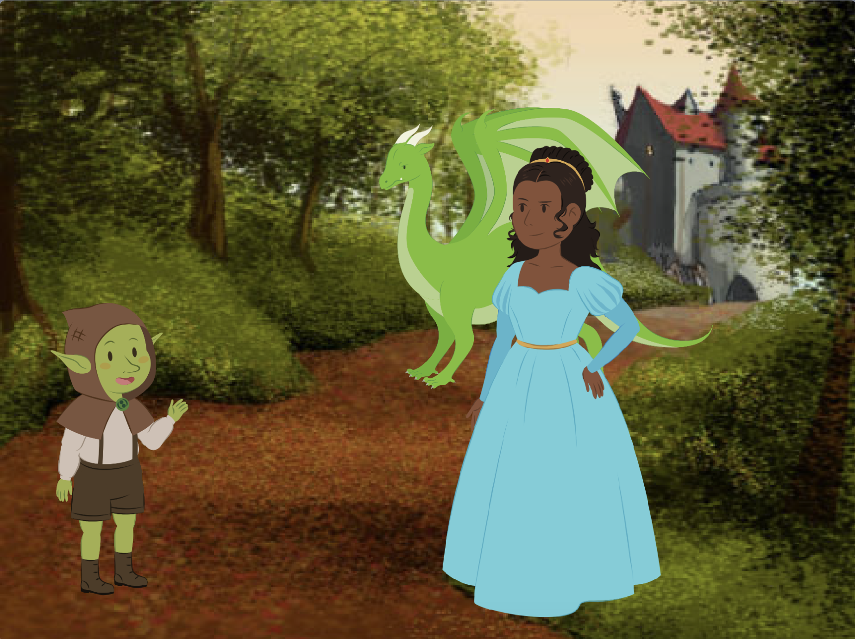
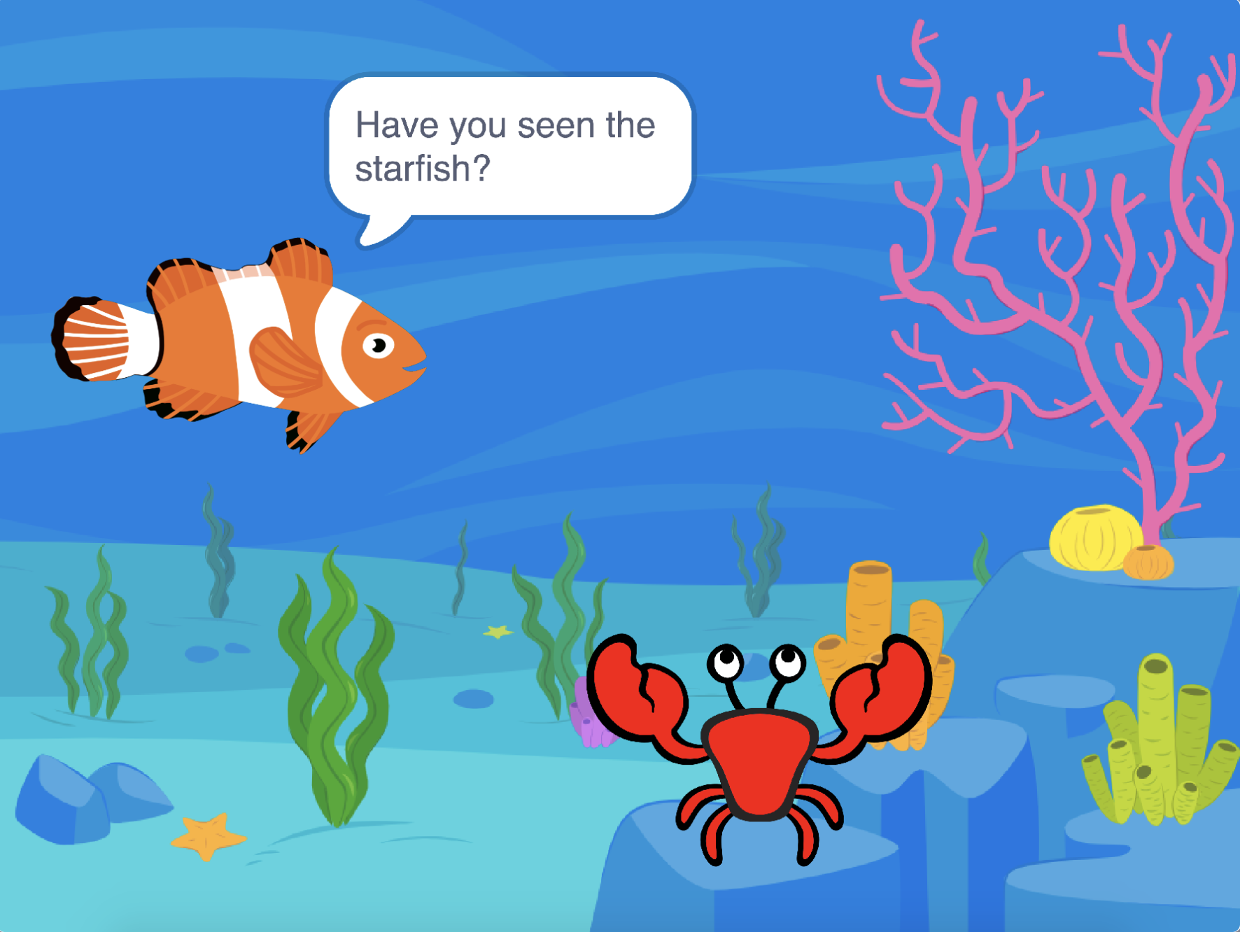
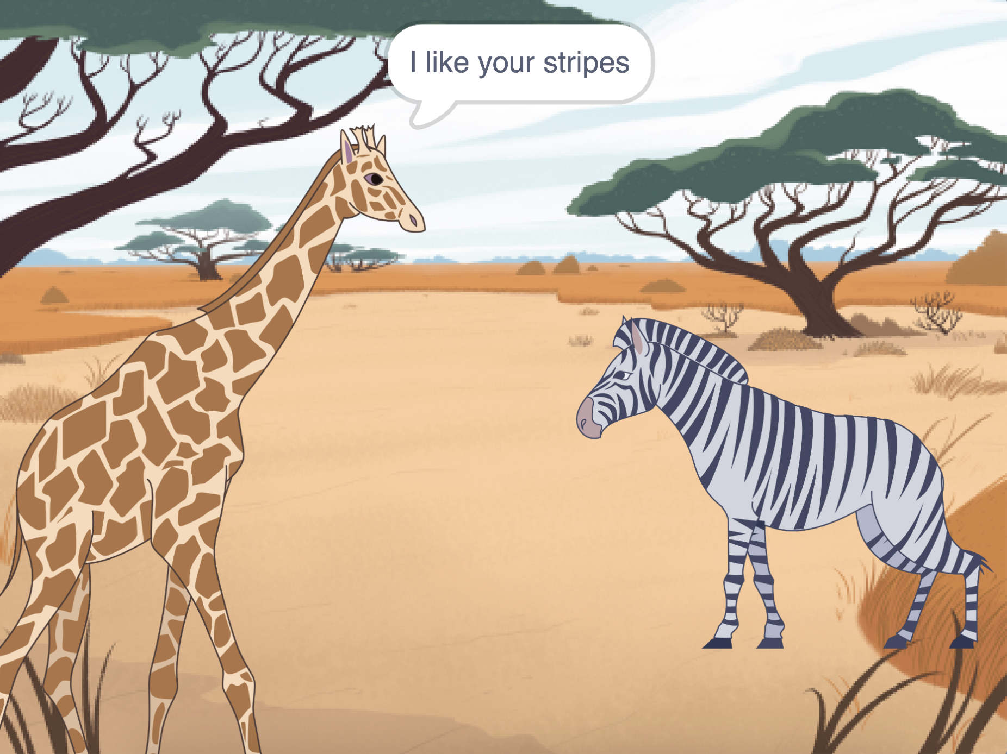
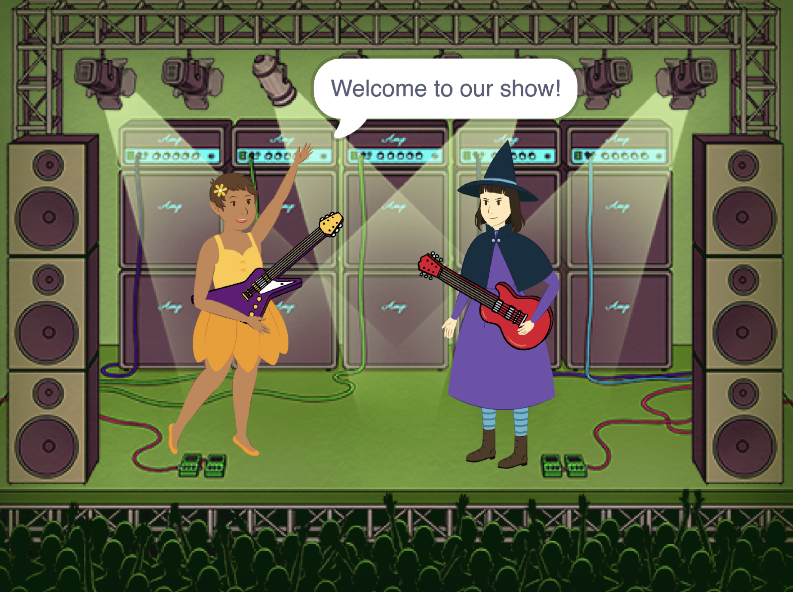

Create a Story Cards
Choose characters, add conversation, and bring your story to life.
scratch.mit.edu
Set of 9 cards

Slide 2

Create a Story Cards
Start with the first card, and then try the other cards in any order:
Start a Story
Start a Conversation
Switch Backdrops
Click a Character
Add Your Voice
Glide to a Spot
Walk onto the Stage
Respond to a Character
Add a Scene
scratch.mit.edu
Set of 9 cards

Slide 3


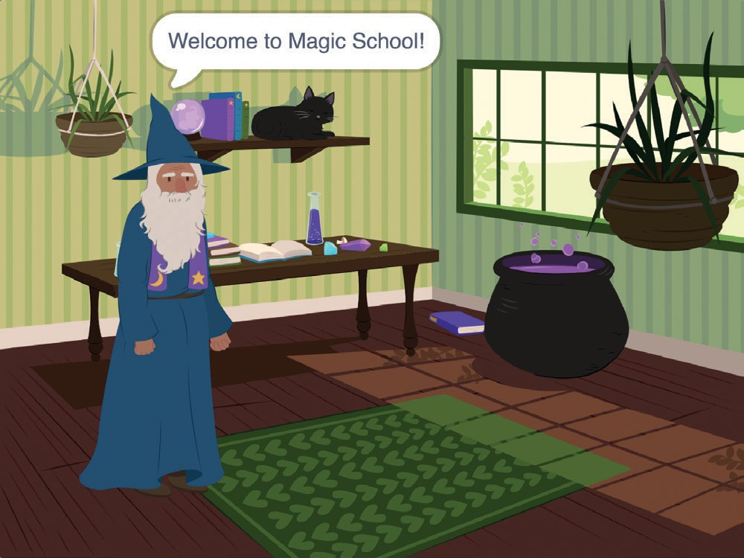

Start a Story
Set the scene and have a character say something.
Create a Story
1

Slide 4

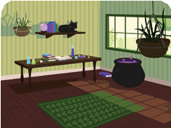

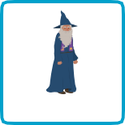
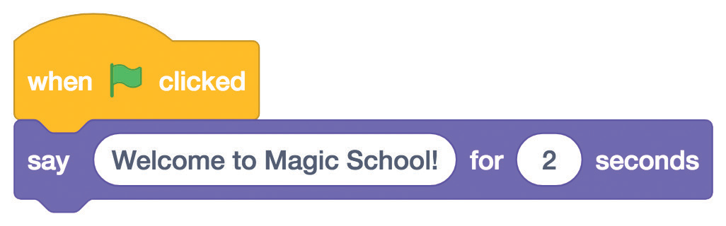
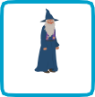

Start a Story
scratch.mit.edu
GET READY
Choose a backdrop.
Witch House
Choose a character.
Wizard
ADD THIS CODE
Wizard
Type what you want your character to say.
TRY IT
Click the green flag to start.

Slide 5
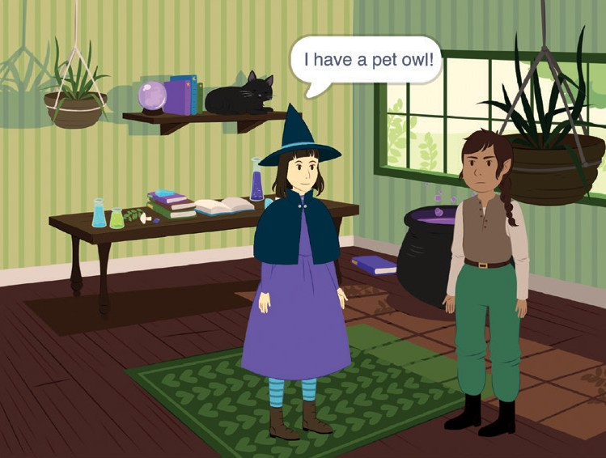
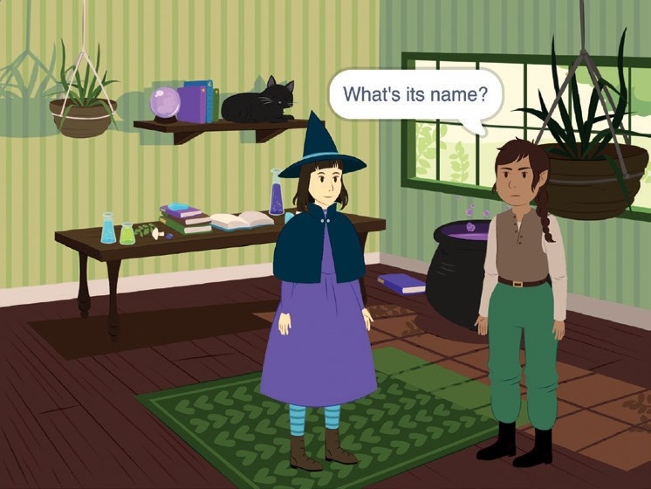
Start a Conversation
Make two characters talk to each other.
Create a Story
2

Slide 6

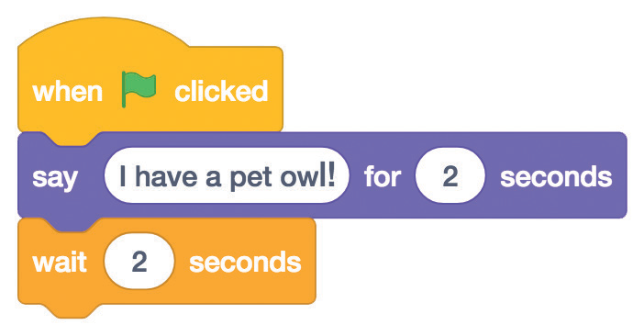
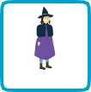
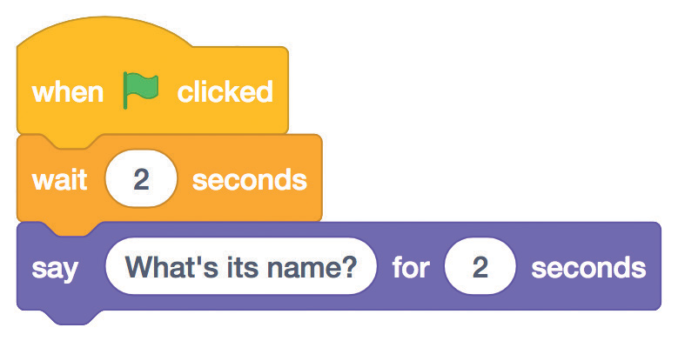
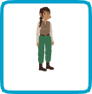



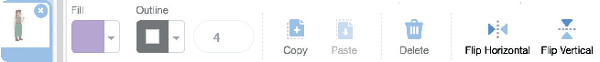
Start a Conversation
scratch.mit.edu
GET READY
Choose two characters, like Witch and Elf.
Witch
Elf
ADD THIS CODE
Click the thumbnail for each character, and then add its code.
Witch
Type what you want each character to say.
Elf
TIP
To change the direction a character is facing, click the Costumes tab, then click Flip Horizontal.

Slide 7
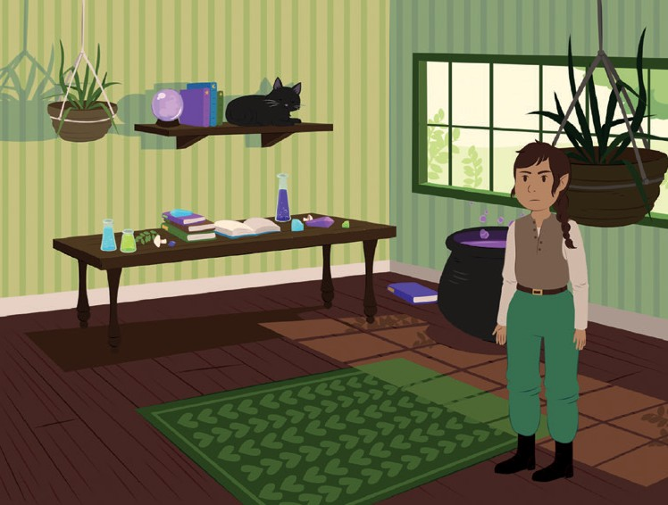
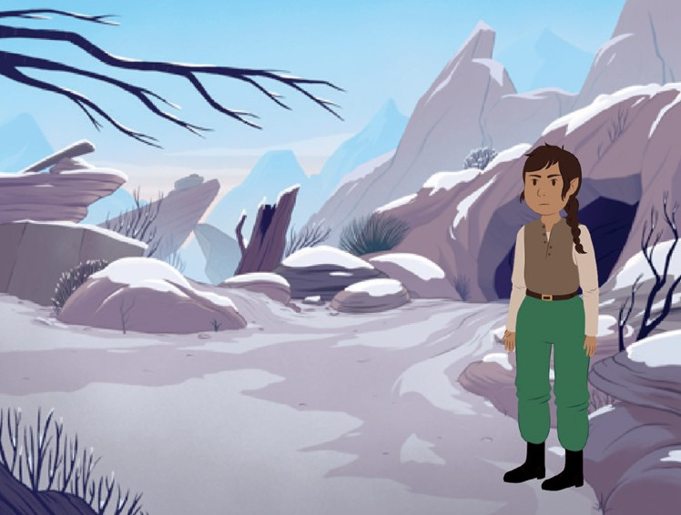
Switch Backdrops
Change from one backdrop to another.
Create a Story
3

Slide 8
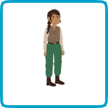
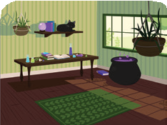
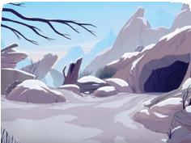
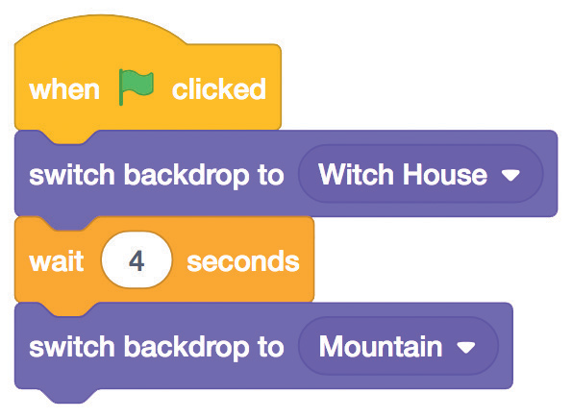
Switch Backdrops
scratch.mit.edu
GET READY
Choose a character.
Choose two backdrops.
Elf
Witch House
Mountain
ADD THIS CODE
Elf
Choose the backdrop you want to start with.
Choose the second backdrop.
TRY IT
Click the green flag to start.
Create a Story

Slide 9
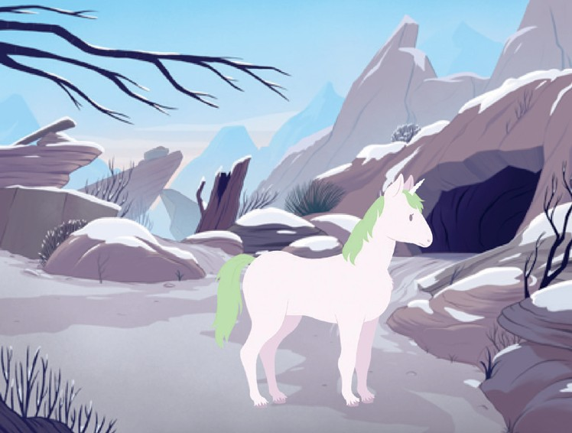

Click a Character
Make your story interactive.
Create a Story
4

Slide 10
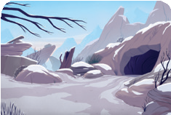

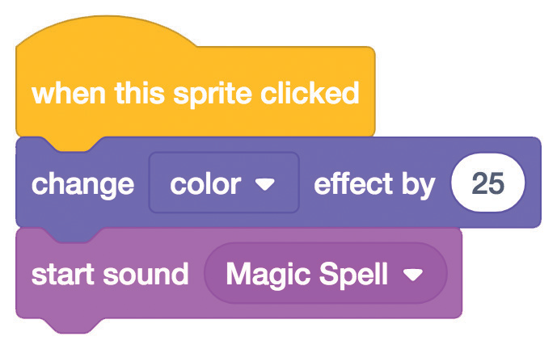

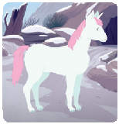
Click a Character
scratch.mit.edu
GET READY
Choose a backdrop.
Mountain
Choose a character.
Unicorn
ADD THIS CODE
You can choose different effects.
Unicorn
Select a sound from the menu.
TRY IT
Click your character.

Slide 11
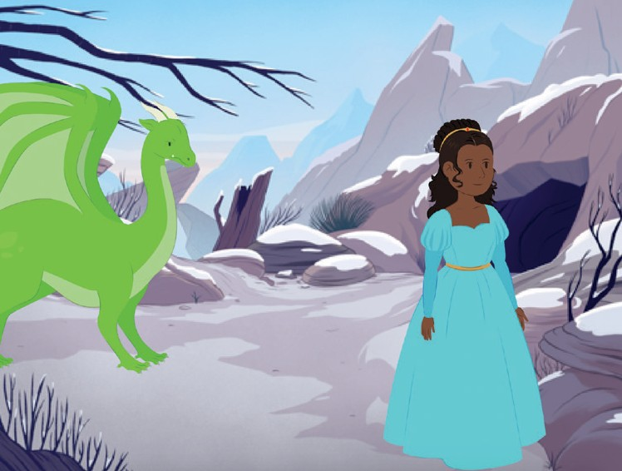
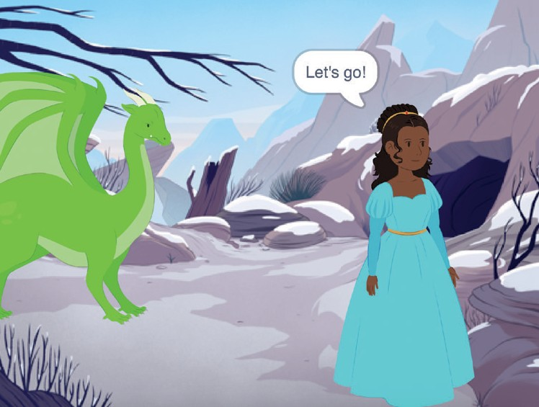
Add Your Voice
Record your voice to make a character talk.
Create a Story
5

Slide 12

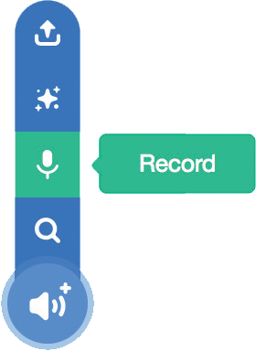
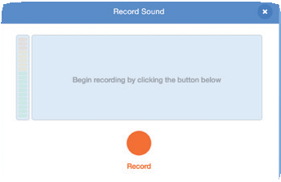



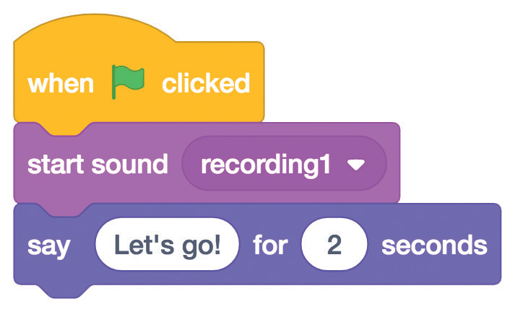

Add Your Voice
scratch.mit.edu
GET READY
Click the Sounds tab.
Click Record.
Choose a sprite.
When you’re done, click Save.
Princess
Choose Record from the pop-up menu.
ADD THIS CODE
Click the Code tab.
Princess
__________
Select your recording from the menu.
TRY IT
Click the green flag to start.
Create a Story

Slide 13
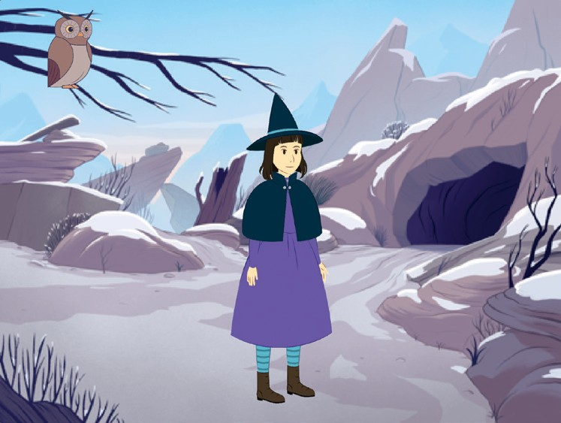
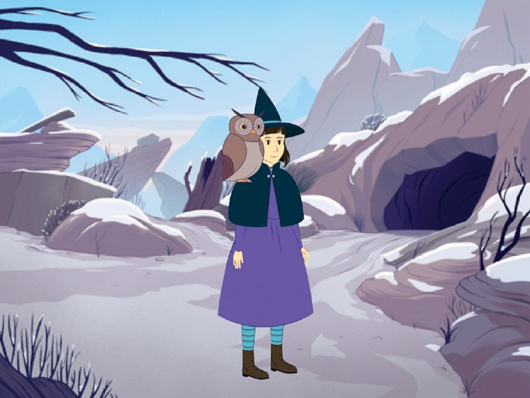
Glide to a Spot
Make a character move across the Stage.
Create a Story
6

Slide 14
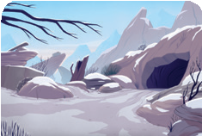

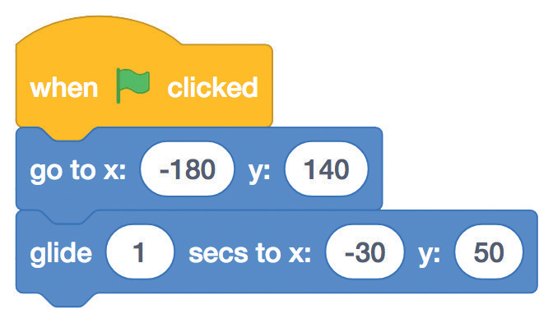


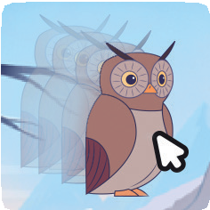
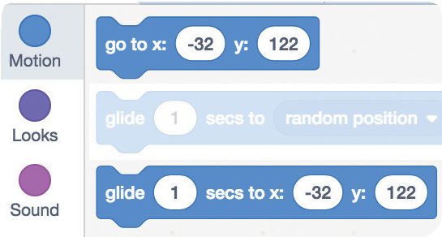
Glide to a Spot
scratch.mit.edu
GET READY
Choose a backdrop.
Mountain
Choose a character.
Owl
ADD THIS CODE
Owl
TRY IT
Click the green flag to start.
TIP
When you drag a sprite, the numbers for x and y will update in the blocks palette.
Create a Story

Slide 15
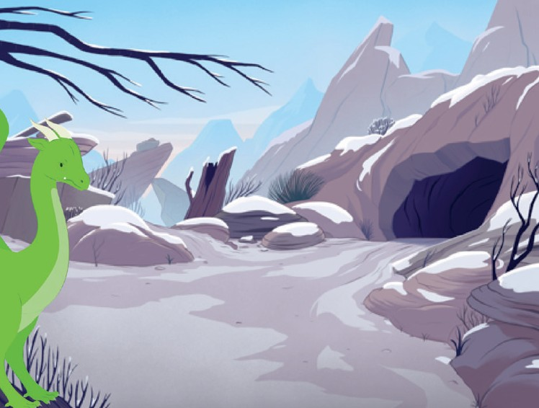
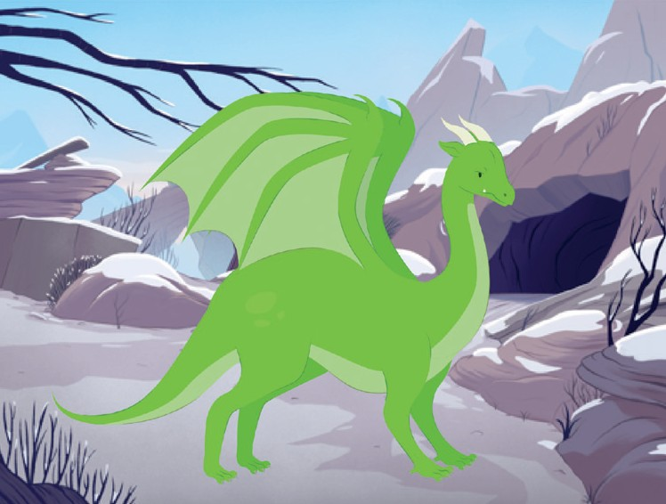
Walk onto the Stage
Have a character enter the scene.
Create a Story
7

Slide 16





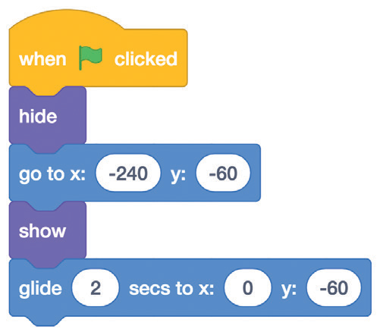

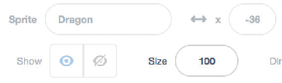


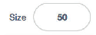
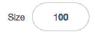
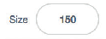
Walk onto the Stage
scratch.mit.edu
GET READY
Choose a backdrop.
Mountain
Choose a character.
Dragon
ADD THIS CODE
Dragon
Type -240 to place your sprite at the left edge of the Stage.
Change this number to glide faster or slower.
TIP
Change the size of a sprite by typing a smaller or larger number.
Create a Story

Slide 17
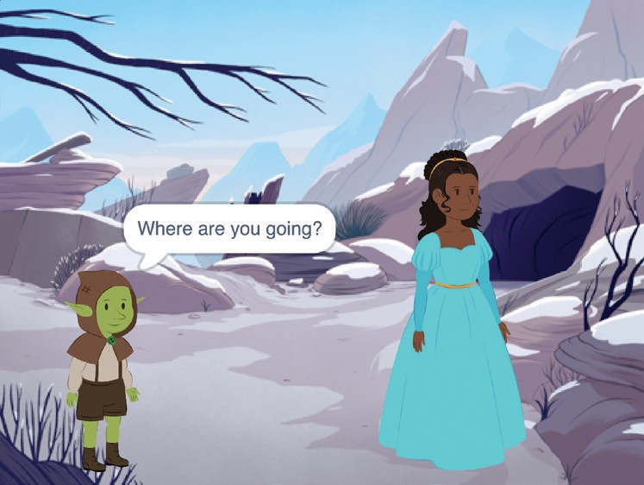
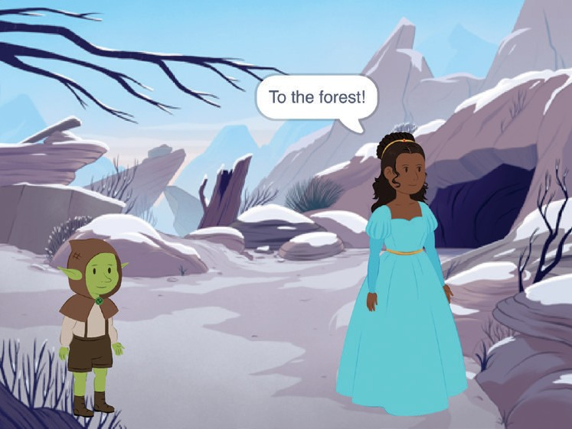
Respond to a Character
Coordinate a conversation so that one character talks after another.
Create a Story
8

Slide 18



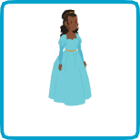
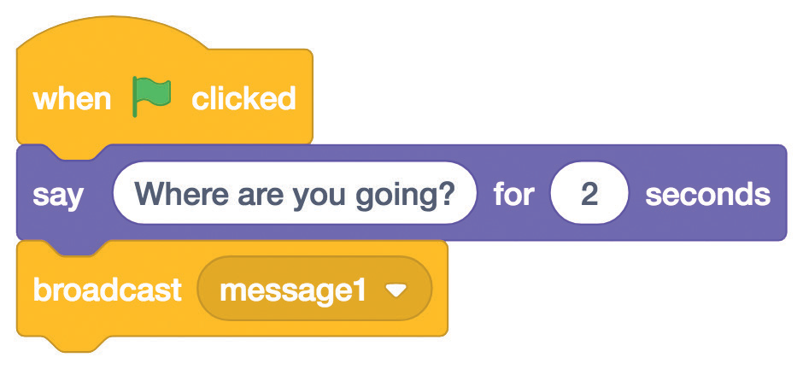
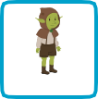
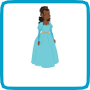


Respond to a Character
scratch.mit.edu
GET READY
Choose a backdrop.
Mountain
Choose two characters.
Goblin
Princess
ADD THIS CODE
Click the thumbnail for each character, and then add its code.
Goblin
Broadcast a message.
Tell this character
what to do when it receives the broadcast.
Princess
TIP
You can click the menu to add a new message.
Create a Story

Slide 19


Add a Scene
Create multiple scenes with different backdrops and characters.
Create a Story
9

Slide 20







Add a Scene
scratch.mit.edu
GET READY
Choose two backdrops.
Choose a character.
Witch House
Mountain
Fox
ADD THIS CODE
Fox
Choose the backdrop name from the menu.
TRY IT
Click the green flag to start.

